Slide 1
Interest Rate Risk
Chapter 14

Slide 2
Types of Rates
Treasury rates
Overnight rates (SOFR, SARON, SONIA, ESTER, TONAR, etc.)
Reference Rates (LIBOR has been discontinued and the new reference rates proposed by regulators are the overnight rates)
Repo Rates

Slide 3
Repo Rate
A financial institution owning securities agrees to sell them today for a certain price and buy them back in the future for a slightly higher price
The interest on the loan is the difference between the two prices

Slide 4
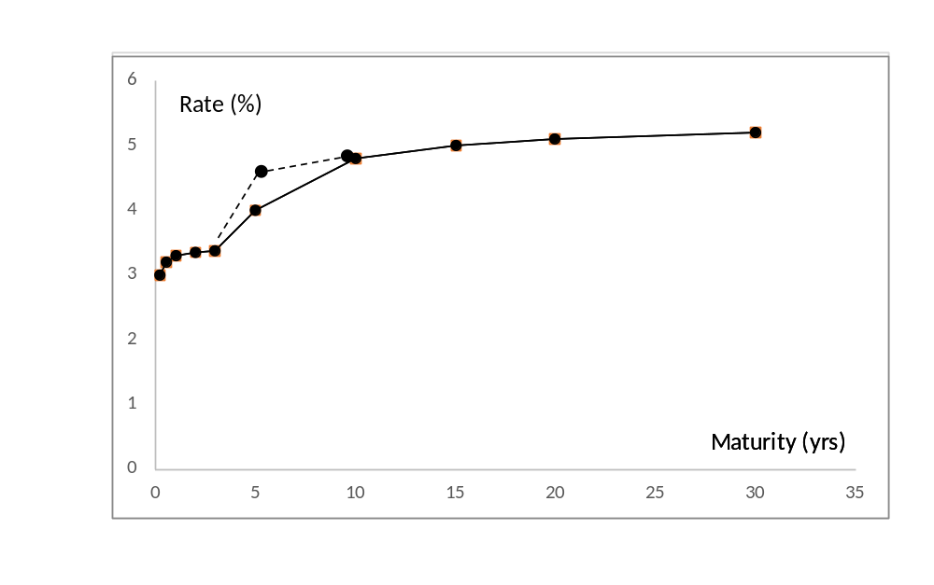
Multiple Vertices (Figure 14.1)
Ten vertices are typically monitored on a yield curve and deltas are calculated with respect to a one-basis point change in each vertex

Slide 5
Use of a Single Correlation Measure for Two Term Structures
Alternatives:
Assume that correlation between a vertex in TS1 and a vertex in TS2 are the same for all pairs of vertices (leads to equation 14.2)
Calculate SD of portfolio from TS1 deltas and SD of portfolio from TS2 deltas. Use the correlation to combine the two SDs (leads to equation 14.3)

Slide 6
Principal Components Analysis
Attempts to identify standard shifts (or factors) for the yield curve so that most of the movements that are observed in practice are combinations of the standard shifts

Slide 7
Results for U.S. Treasury Rates(Tables 14.3 and 14.4)
The first factor is a roughly parallel shift (87.3% of variance explained)
The second factor is a twist (extra 8.3% of variance explained)
The third factor is a bowing (extra 2.1% of variance explained)

Slide 8
Calculating VaR and ES (Section 14.3.1)
Calculate the exposure to each PCA factor
The factors are uncorrelated
From the standard deviation of each factor score the standard deviation of the change in the value of the portfolio can be calculated
Assuming normally distributed factors, VaR and ES can then be calculated

Slide 9
The Three Factors (Figure 14.2)

Slide 10
Management of Net Interest Income (Table 14.6)
Suppose that the market’s best guess is that future short-term rates will equal today’s rates
What would happen if a bank posted the following rates?
How can the bank manage its risks?
Maturity (yrs) | Deposit Rate | Mortgage Rate
1 | 3% | 6%
5 | 3% | 6%

Slide 11
Management of Net Interest Income
Most banks have asset-liability management groups to manage interest rate risk
When long term loans are funded with short term deposits interest rate swaps can be used to hedge the interest rate risk
But this does not hedge the liquidity risk

Slide 12
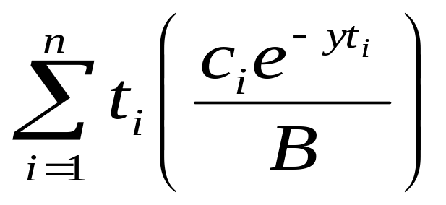
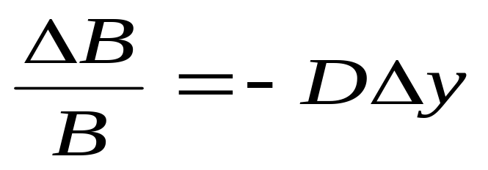
Duration (Section 14.5)
Duration of a bond that provides cash flow c_{i} at time t_{i} is
where B is its price and y is its yield (continuously compounded)
This leads to

Slide 13
Calculation of Duration for a 3-year bond paying a coupon 10%. Bond yield=12%. (Table 14.8)
Time (yrs) | Cash Flow ($) | PV ($) | Weight | Time × Weight
0.5 | 5 | 4.709 | 0.050 | 0.025
1.0 | 5 | 4.435 | 0.047 | 0.047
1.5 | 5 | 4.176 | 0.044 | 0.066
2.0 | 5 | 3.933 | 0.042 | 0.083
2.5 | 5 | 3.704 | 0.039 | 0.098
3.0 | 105 | 73.256 | 0.778 | 2.333
Total | 130 | 94.213 | 1.000 | 2.653

Slide 14
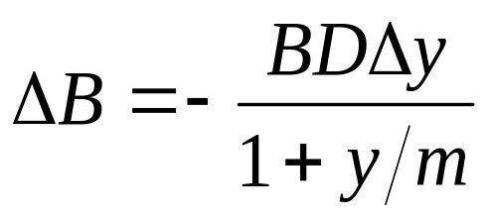
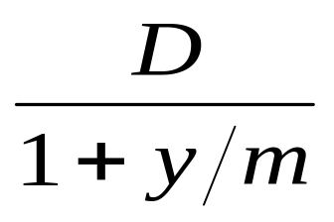
Duration Continued
When the yield y is expressed with compounding m times per year
The expression
is referred to as the “modified duration”

Slide 15
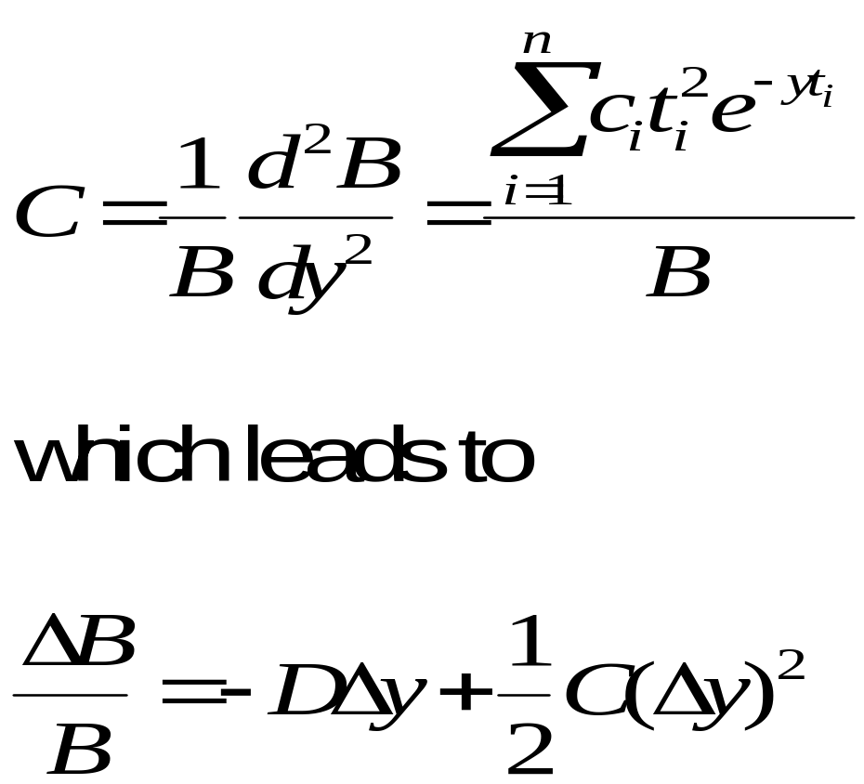
Convexity (Section 14.6)
The convexity of a bond is defined as

Slide 16
Portfolios
Duration and convexity can be defined similarly for portfolios of bonds and other interest-rate dependent securities
The duration of a portfolio is the weighted average of the durations of the components of the portfolio. Similarly for convexity.

Slide 17
What Duration and Convexity Measure
Duration measures the effect of a small parallel shift in the yield curve
Duration plus convexity measure the effect of a larger parallel shift in the yield curve
However, they do not measure the effect of non-parallel shifts

Slide 18
Other Measures
Dollar Duration: Product of the portfolio value and its duration
Dollar Convexity: Product of convexity and value of the portfolio
DV01: Dollar impact of a one-basis-point parallel shift

Slide 19
Starting Zero Curve (Figure 14.5)

Slide 20
Parallel Shift

Slide 21
Partial Duration
A partial duration calculates the effect on a portfolio of a change to just one point on the zero curve

Slide 22
Partial Duration continued
(Figure 14.6)

Slide 23
Example (Table 14.10)
Maturity yrs | 1 | 2 | 3 | 4 | 5 | 7 | 10 | Total
Partial duration | 0.2 | 0.6 | 0.9 | 1.6 | 2.0 | −2.1 | −3.0 | 0.2

Slide 24
Partial Durations Can Be Used to Investigate the Impact of Any Yield Curve Change
Any yield curve change can be defined in terms of changes to individual points on the yield curve
For example, to define a rotation we could change the 1-, 2-, 3-, 4-, 5-, 7, and 10-year maturities by −3e, − 2e, − e, 0, e, 3e, 6e

Slide 25
Combining Partial Durations to Create Rotation in the Yield Curve
(Figure 14,7)

Slide 26
Impact of Rotation
The impact of the rotation on the proportional change in the value of the portfolio in the example is

Slide 27
Alternative approach (Figure 14.8)
Bucket the yield curve and investigate the effect of a small change to each bucket

Slide 28
Alternatives for Calculating Multiple Deltas to Reflect Non-Parallel Shifts in Yield Curve
Shift individual points on the yield curve by one basis point (the partial duration approach)
Shift segments of the yield curve by one basis point (the bucketing approach)
Shift quotes on instruments used to calculate the yield curve
Calculate deltas with respect to the shifts given by a principal components analysis.

